Slide 1
Fundamentals of Discipline
Supervisor Guide
2023

Slide 2


Group Discussion
What are some of your concerns or challenges with discipline?

Slide 3
Purpose
The purpose of this course is to guide supervisors through progressive discipline rules by providing tools and resources necessary to be successful.
Notes:
advance the slide.)

Slide 4
Objectives
Understand progressive discipline
Explain the difference between informal and formal discipline
Identify what NDOT forms are available
Know when to call HR

Slide 5

Employee Discipline
What is Discipline?
dis·ci·pline
noun:
the practice of training people to obey rules or a code of behavior, using punishment to correct disobedience.
verb:
train oneself to do something in a controlled and habitual way

Slide 6
Employee Discipline
Reasons for Employee Discipline procedures
Provide all employees an opportunity to correct their behavior & meet the expectations of the supervisor.
Ensure employee accountability.
Create a defensible procedure for discipline.
Process for terminating an employee who has committed a serious offense or refuses to improve their performance

Slide 7

Human Resources Policies & Procedures
3 Resources:
NAPE/AFSCME Labor Contract
State of Nebraska Classified System Personnel Rules & Regulations
NDOT Human Resources Policies & Procedures
Become familiar with them as resources
HR can answer questions when needed.
Notes:
Tim: We’ll use the manuals

Slide 8


Group Discussion
What are some examples where you’ve had to discipline an employee in your career?
(No employee names or identifiers please!)

Slide 9


Applying Discipline
Consistent
Fair
Prompt
Just Cause
Progressive

Slide 10
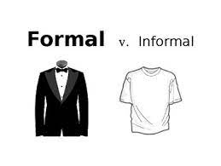
Employee Discipline
Informal Corrective Action
vs
Formal Discipline

Slide 11
Informal Corrective Action
What it is…
Identify unacceptable behavior or performance
Set clear expectations
Guide and motivate to improve performance or conduct
What it is NOT…
Punishment
Filed in personnel file
Involving HR
Notes:
Corrective action is not considered “discipline” and is primarily focused on improving the employee’s performance, attendance or conduct through dialogue and setting expectations
Your goal as a manager is to guide the employee to correct performance, attendance or behavior, not to punish the employee.
Non-disciplinary corrective action typically includes informal discussions, verbal warnings, letters expectation, or a Performance Improvement Plan.
Be specific in describing the unacceptable performance or behavior.

Slide 12
Formal Disciplinary Action
Formal Disciplinary Action is used when:
An employee’s action is a direct violation of reasonable work rules and/or policy.
Repeated counseling is met with failure or a flagrant act of misconduct occurs.
There is a pattern of violations that continue to occur.

Slide 13
Employee Discipline
Formal Discipline action:
Is always documented
Is planned in advance, with HR
Follows set guidelines
Must be based on “just cause”

Slide 14
Factors in determining Just Cause
Use the following six factors to assess whether there is just cause for corrective action:
Adequate notification of performance or conduct issues
Reasonable expectations and standards
Substantial evidence
Fair and objective assessment
Consistent treatment
Appropriate corrective measures
Notes:
Notified that their performance or behavior is unacceptable
Advised of the potential consequences for failing to meet performance or behavioral expectations (including possible corrective action)
For example, notification of unacceptable conduct could be provided through making employees aware of published performance or behavioral standards (such as a NDOT policy or District procedure) or through previous counseling or coaching regarding that behavior.
Reasonable expectations and standards
The Department’s policies, procedures, practices, standards, and work rules must be reasonably related to efficient and safe operations.
Substantial evidence
The assessment must reveal substantial evidence of the employee’s responsibility for the performance issue or offense.
A fair and objective assessment includes gathering as much of the following information as possible:
Date, time and location the incident occurred
List of people who may have been involved or witnessed
Statements from witnesses and participants, as well as from the employee.
Documents or records related to the incident (ie., police report, accident report, damage estimate, etc)
What is the impact of the incident on other people, the District, and the Agency?
Consistent treatment
Performance expectations, standards, and corrective actions should be applied equally. Employees in similar situations should be treated comparably. Be sure to review past practices so that you can remain consistent with all of your employees.
Appropriate corrective measures
A corrective measure must match the seriousness of the offense. Additionally, you must take the individual’s employment and performance history into account. In other words, minor offenses and first occurrences typically warrant less severe action. Major offenses and repeated occurrences typically warrant stronger action.

Slide 15

Group Discussion
What have you learned about discipline from your experience?

Slide 16
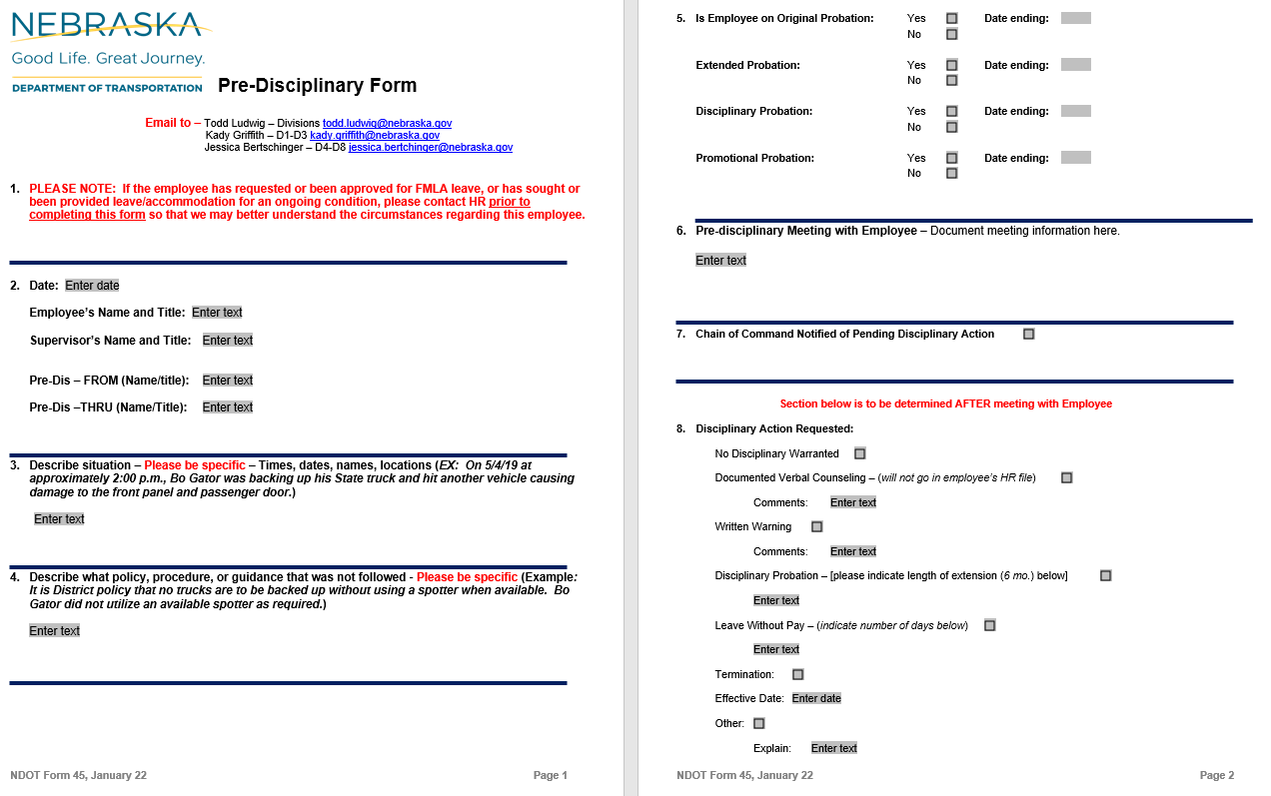
Forms – NDOT 45

Slide 17
Key Elements of a pre-discipline memo:
Obtain Pre-disciplinary memo from HR
Notice/explanation of allegations and specific violation
Citation of the rule or policy violated
Date, time and place of meeting-*you will complete*
24 hour advance notification of the meeting is REQUIRED

Slide 18
Pre-Discipline Meeting
State the facts and review allegations.
Employee presents position and mitigating evidence.
Document what everyone says.
DO NOT:
  Give your opinion of the situation - Facts only!
  Make promises or speculate what discipline will be imposed.

Slide 19
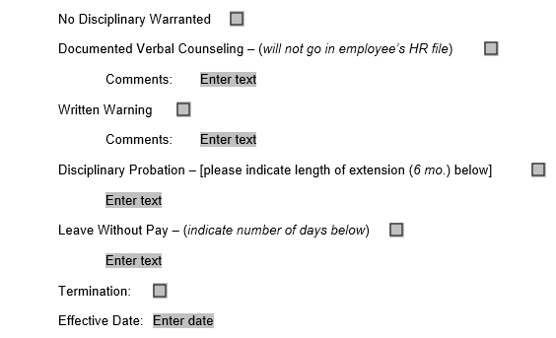
Types of Discipline

Slide 20
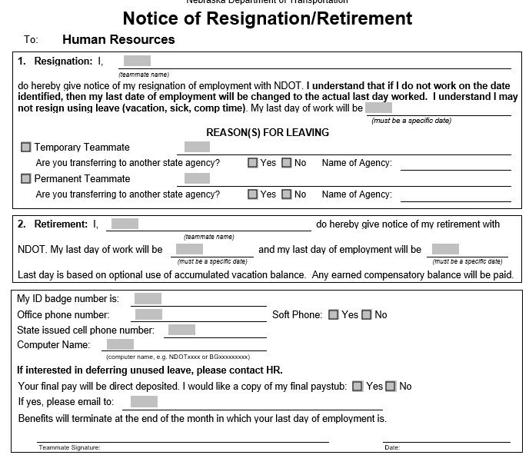
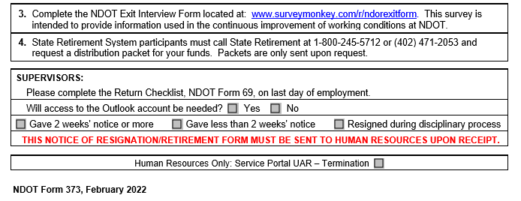
Forms – NDOT 373

Slide 21
Common Missteps
Not documenting properly…or at all (date, witnesses, details and quotes)
Incorrect dates input on memos
Missed deadlines; not acting in a timely manner
Inconsistent disciplinary actions
Adding or embellishing details that are false

Slide 22

Questions?

Slide 23
Break

Slide 24
Fundamentals of
Documentation
2023

Slide 25

PURPOSE
The purpose of this course is to guide supervisors how to effectively document personnel issues.
Notes:
advance the slide.)

Slide 26

Group Discussion
Why is documentation important?

Slide 27
Documentation 101
  To adapt an adage : if you don’t write it down, it didn’t happen.
  Always document under the assumption that a third party may, at some point, review your records and they need to see the whole story.
  Managers, HR, and possibly legal have a responsibility to manage the information – shared in writing or verbally – regarding an employee’s performance or personal status.
  This information must be held in confidence and only shared with people who have a need to know.
  Documentation also show’s the steps we’ve taken to help someone be successful.

Slide 28

Tips for Documentation
Don’t Wait! Document Immediately: We all lead busy lives and juggle many responsibilities. However, priorities can change by the moment and our memories can fade surprisingly quickly. All documentation should be completed within 24 hours.
Whenever possible, date stamp documentation or record in an electronic system that allows you to determine when the note was created. You can also consider emailing yourself documentation as a back-up.

Slide 29
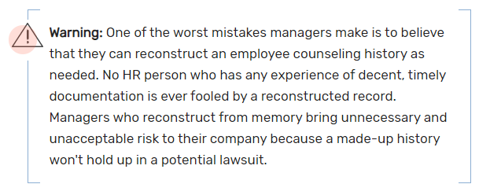
How to document
Notes:
Don’t Wait! Document Immediately: We all lead busy lives and juggle many responsibilities. However, priorities can change by the moment and our memories can fade surprisingly quickly. All documentation should be completed within 24 hours.
Whenever possible, date stamp documentation or record in an electronic system that allows you to determine when the note was created. You can also consider emailing yourself documentation as a back-up.

Slide 30

Tips for Documentation
Get Input and Back Up: Ask for Written Statements by Other Managers/Employees When Applicable: For more complex issues, or issues in which one employee alleges wrongdoing by another, ask the employee to document their issue, concern, observation, etc. immediately.
Keep it Simple: You can use a simple incident log for most items (like attendance, missing deadlines, not making it to required meetings or trainings, etc.). When the issue is a bit more complex, remain objective. Stick to the facts. Document who was involved, what happened, when and where. Do include a brief history of the issue, when applicable.

Slide 31

Tips for Documentation
Create a Secure Filing System: Employee relations documentation is very sensitive and is confidential to the extent that you are sharing with your superiors, HR Business Partner or legal counsel. Keep it under lock and key, or password-protected at all times.

Slide 32
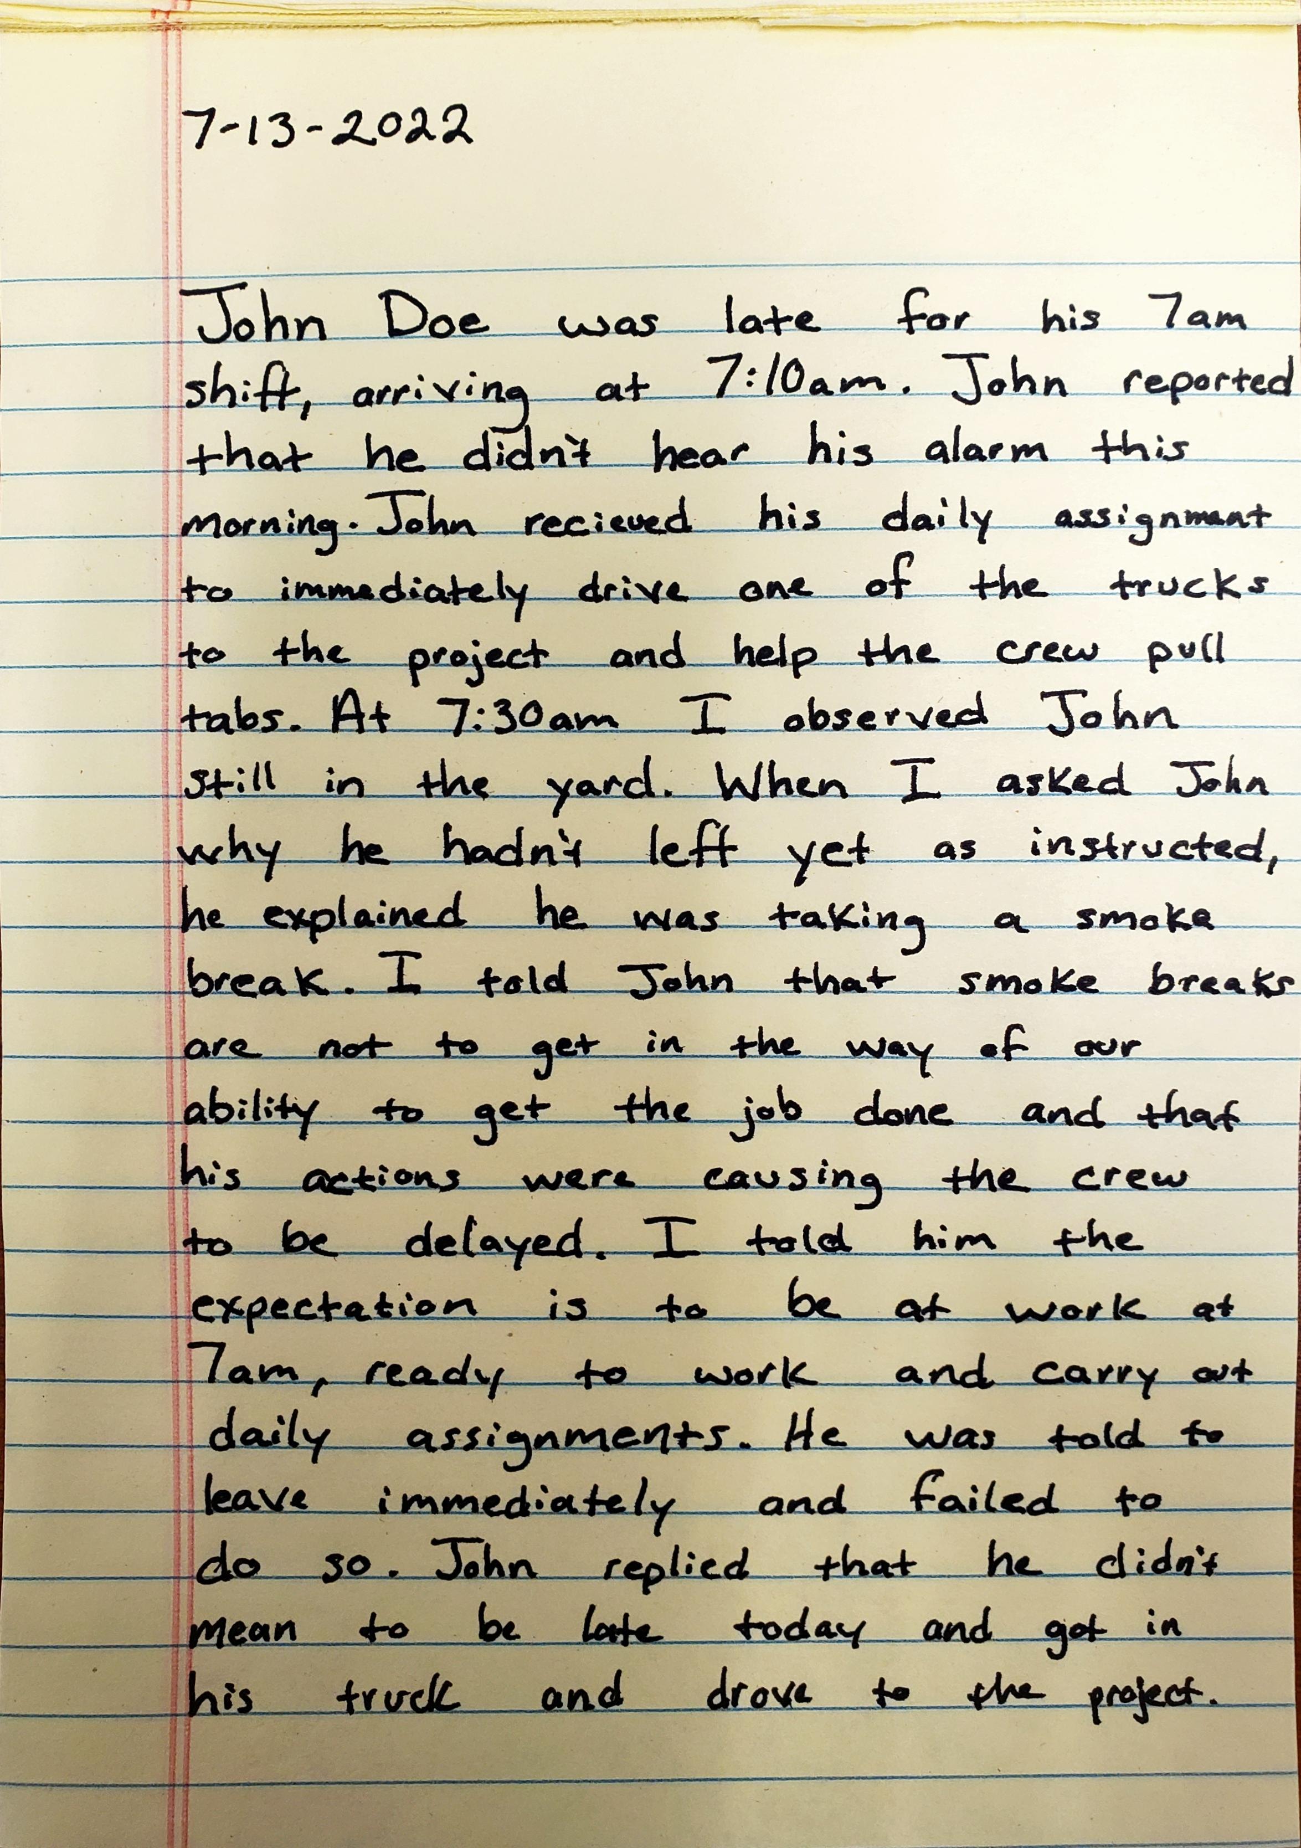
Seven Rules for Documenting/Coaching
Describe the expectations. Clearly state what the job description or the policies require.
  If you don’t clearly state expectations, you can’t prove how employees failed to follow the expectation.
  A third-party could ask, “how did the employee know they were supposed to do that?”
  Be specific. Don’t tell a worker they must “show up on time.” Instead, say, “Your shift begins at 7 a.m. and you should be in the crew room waiting for daily assignments and ready to go.”
Notes:
Tim: We’ll use the manuals

Slide 33
Seven Rules for Documenting/Coaching
Describe the behavior or performance that needs addressed.
  Describe the conduct, not the person.
  Avoid making broad judgments such as “always” and “never,” which can be easily disputed by the employee’s attorney.
  Best practice is to record specific dates to show when incident occurred.
  Keep your observations job-related. Describe how the worker’s actions/behavior impact others and the Agency.
Notes:
“John has been late at least once a week for the past four weeks”
“John arrived for his 7am shift at 7:15am on 7/13/23”
“…his action cause the crew to start late because they are waiting for him and is causing tension on the crew”

Slide 34
Seven Rules for Documenting/Coaching
Include the employee’s explanation for why expectations aren’t being met.
  Having a conversation shows the manager’s attempt to be fair and learn how to help the individual and understand what happened.
  Rushing to judgment can backfire on a manager.
Notes:
Discussion: Why might that happen? Has anyone ever witnessed that?

Slide 35

Seven Rules for Documenting/Coaching
Coach and document how the employee can improve their performance.
  This is more like coaching the employee to do better.
  Include specific steps the employee will take to improve and what you will do to help.
  Be realistic and focus on a few key areas.
  Don’t forget to write it down!

Slide 36

Group Discussion
What are some examples of successful coaching that you’ve done or seen?
Notes:
Or, how have you coached employees out of bad habits they’ve had?

Slide 37

Seven Rules for Documenting/Coaching
Set deadlines for correcting the behavior or performance.
  Rather than saying, “We expect you to turn things around immediately.” That can mean different things to different people. Try, “We expect your paperwork will be turned in by 5 p.m. tomorrow.”
  Follow up at the specified deadline. If you don’t follow up, it shows you don’t care.
  Keep a written record of what happened, including the employee’s explanation.

Slide 38
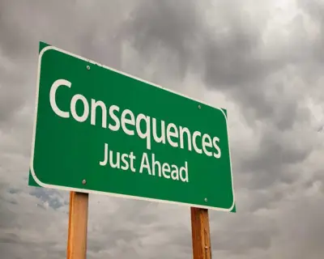
Seven Rules for Documenting/Coaching
Describe possible consequences.
  Provide that progressive discipline may be used if performance/actions are not corrected.
  Do not use this to threaten or intimidate teammates. This is only providing them insight on what could happen if they do not take this seriously and work to correct the issue.

Slide 39

Seven Rules for Documenting/Coaching
Avoid vague phrases that could provide grounds for discrimination lawsuits.
  Terms like “bad attitude” or because he isn’t a good “culture fit” are not valid reasons to discipline/term.
  Those are red flags that could cause the employee to believe the firing is attributable to his or her gender, race or national origin—or to his or her membership in another group protected under federal civil rights laws.

Slide 40
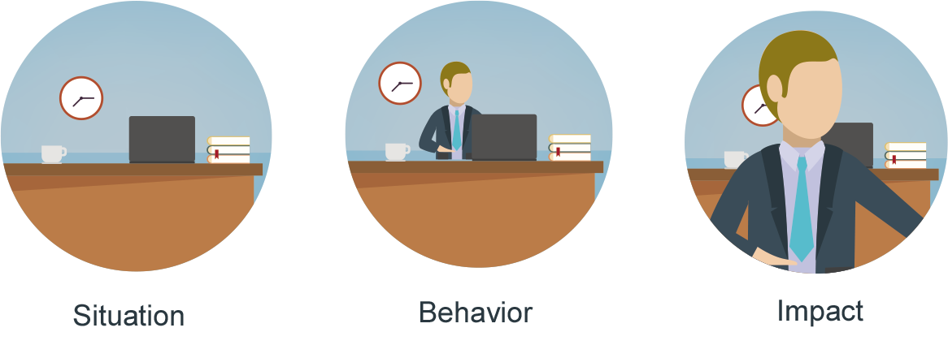
Focus on the Behavior — Not the Person

Slide 41
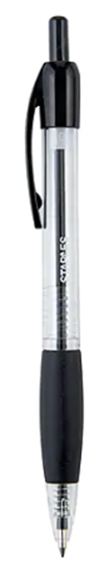

Documentation Do’s
Be accurate
  Don’t make assumptions, don’t embellish or exaggerate facts
Stick to the facts
  Be cautious of judgement statements around employee behavior
Include all details
  Record the who, what, when, where for a complete picture of what is happening
Identify witnesses
  Important for investigations and corroboration
Notes:
Remember to prepare documentation with the expectation that someone with no knowledge of what happens in your District (internal or external) will review it. Include enough information to show what happened, what steps were taken, and offer the individual an opportunity to correct performance.

Slide 42

Where documentation is used
Annual Performance Reviews
Performance Improvement Plans
Investigations
Disciplinary Process

Slide 43
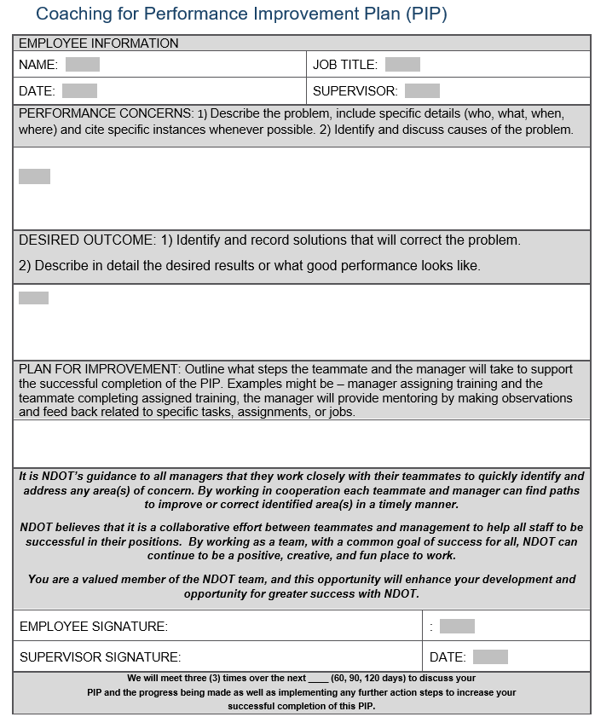
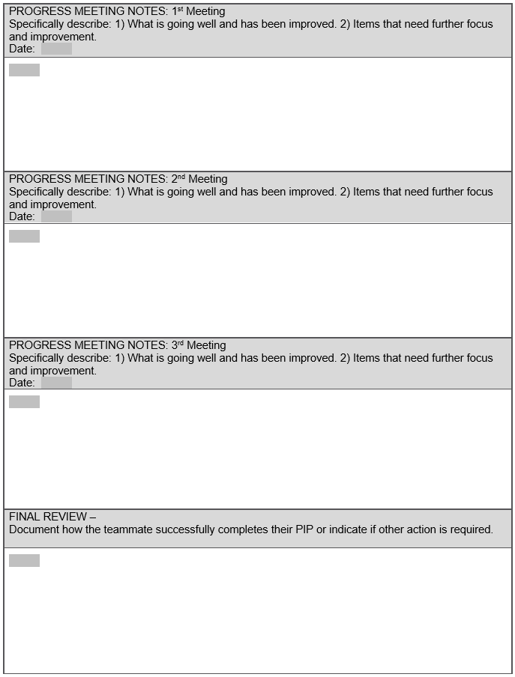
PIP – NDOT 200

Slide 44
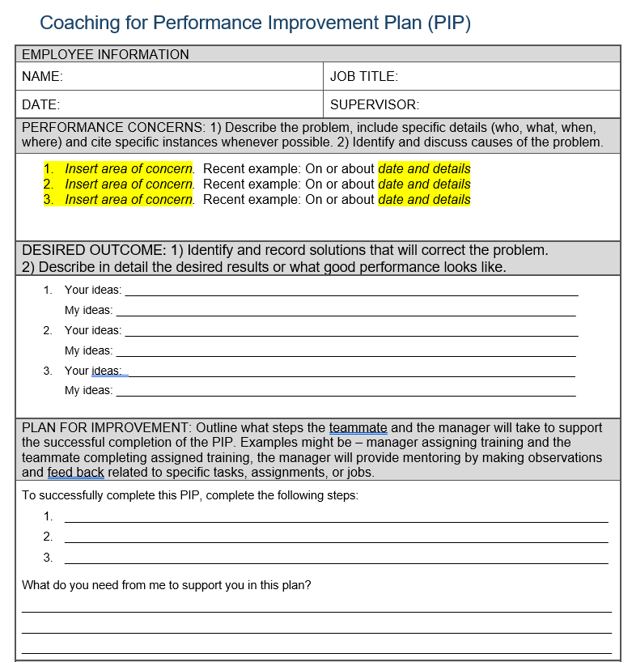
Possible areas of concern:
Not following instructions or procedures
Failure to properly take care of equipment
Aggressive behavior with the crew/failing to maintain teamwork
Failure to maintain appropriate working relationship with supervisor
Lack of regular and reliable attendance
Safety concerns
Not meeting production expectations/standards
Personal phone usage
Failure to complete training

Slide 45
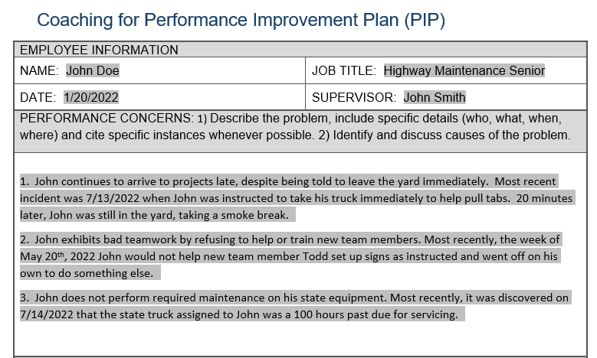
PIP Example

Slide 46
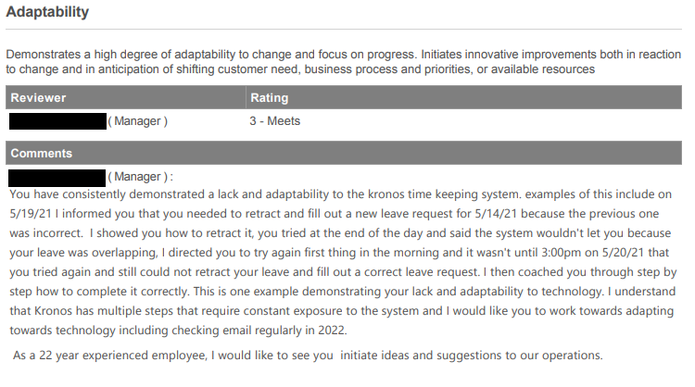
Performance Review Example

Slide 47
QUIZ
When should you document?
    Immediately following the incident.
2. Where should you store employee documents?
    Secure filing system
3. Is HR involved in an Informal Disciplinary action?
    No
4. Where is documentation used?
    Performance Review
    PIP
    Investigation
    Disciplinary Process

Slide 48

Questions?

Slide 49
Thank you!
Please reach out to me with any questions or for help.
Meredith McAdams
402-432-0038
Meredith.mcadams@nebraska.gov

