Slide 1
2015 NDOR Omaha Metro Interstate and Expressway System Projects

Slide 2
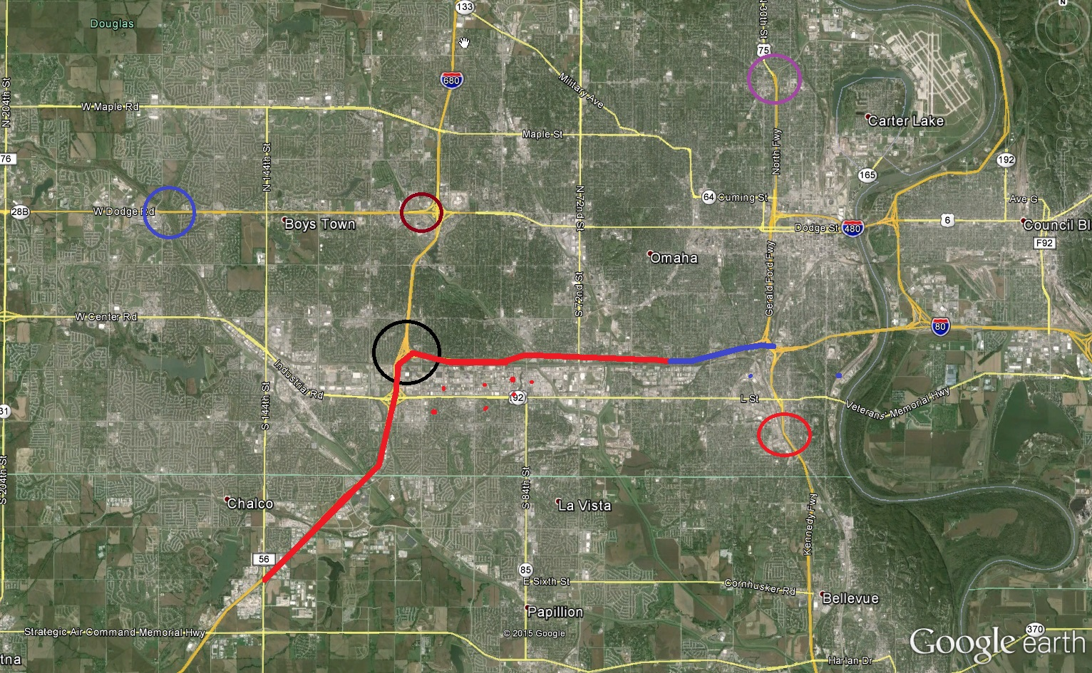
US-75 North Freeway Bridges, Omaha
US-6 West Papillion Creek Near 168th
WB US-6 Over 108th St
SB I-680 to WB I-80 Bridges
I-80 50th St – I-480, Omaha
SB I-680 To EB I-80
EB I-80 to NB I-680
US-75 “Q” St Bridge, Omaha
I-80 N-50 to 50th St

Slide 3
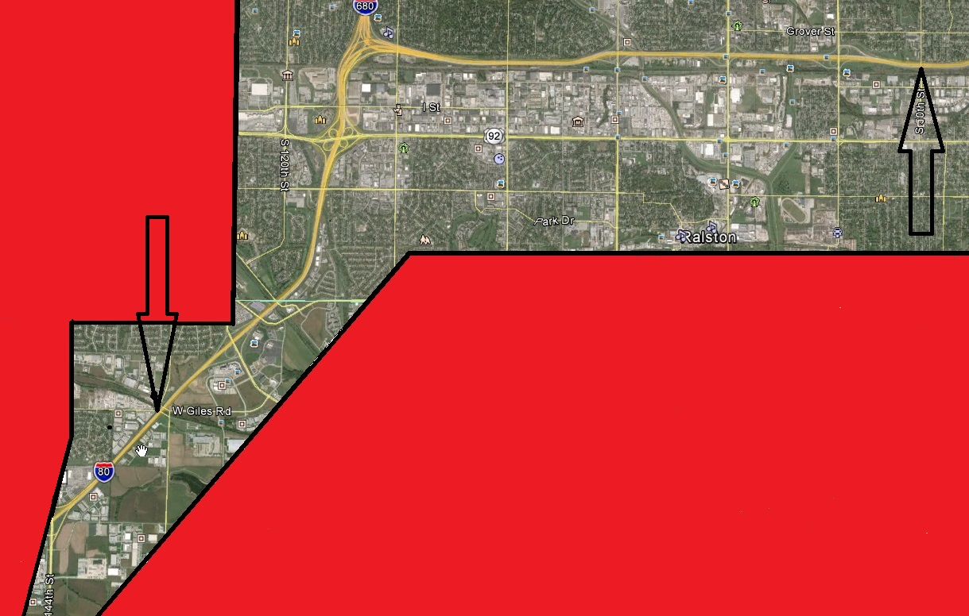
Mainline I-80 N-50 to 50th
IM-80-9(66)
$7.9mil
Project can start April 13th, 2015
150 allotted Working Days
Completion Spring 2016
Work will be both Eastbound and Westbound directions
Work will consist of pavement repair, diamond grinding, joint sealing, and striping

Slide 4
Traffic Restrictions
Construction only during Non- Peak hours
Monday thru Thursday 9:00 p.m. to 6:00 a.m.
Friday 11:00 p.m. to Saturday 7:00 a.m.
Saturday 10:00 p.m. to Sunday 8:00 a.m.
Sunday 10:00 p.m. to Monday 6:00 a.m.
No Work Will be Allowed July 3rd to July 5th And September 5th To 7th
Up to two adjacent lanes can be closed one hour after nonpeak hours begin.
On and Off Ramps may be closed but not consecutive interchanges.

Slide 5
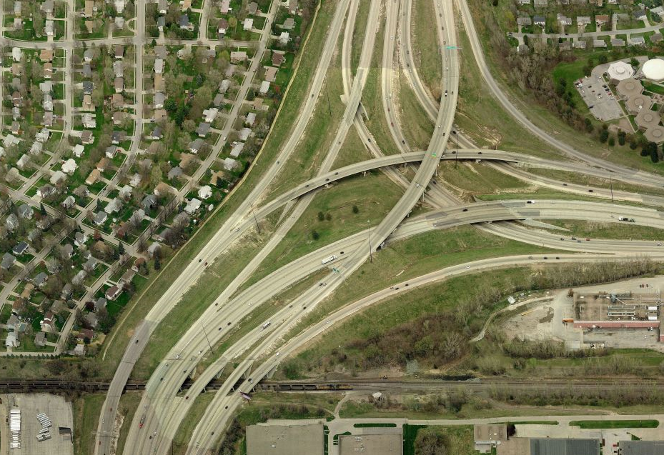


2015 I-80/I-680 Interchange Construction
Bridge Construction
Pavement Construction
Roadway Closure

Slide 6
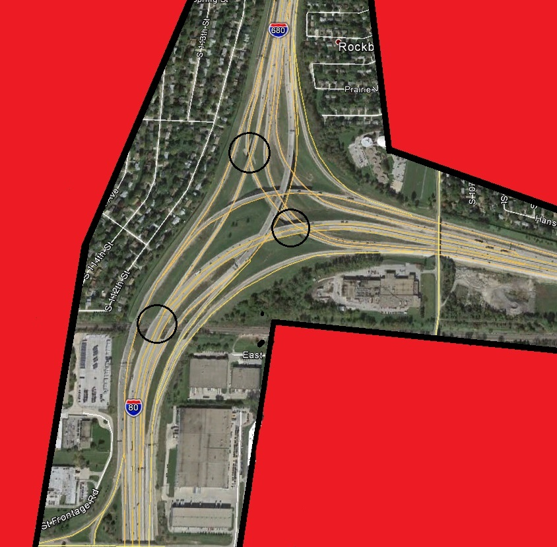
Southbound I-680 to West I-80 Bridges
STR-680-9(1192)
$3.4mil
Project start April 20, 2015
132 calendar days
Completion Aug. 29, 2015
Work will consist of MSE
wall, culverts, approach slabs, bridge repair and 3” asphalt overlay, guardrail

Slide 7
Traffic Restrictions
The WB I-80 Bridge over “SB 680 to EB 80” will be closed three weekends with the traffic diverted to the “WB I-L-Q Collector –Distributor Road” in Phase 1B.
“SB I-680 to WB I-80”, the “West Center On-Ramp to SB Collector-Distributor” and the “SB Collector Distributor On-Ramp to EB I-80” Will Close in Phase 2 and will not open until project complete Aug. 29, 2015.
Throughout construction of project there will be several Non-Peak Hour lane closures. These locations will depend on the phasing timeline of the project.
Non Peak Hours Are:
Monday thru Friday 10:00 p.m. to 6:00 a.m.
Saturday and Sunday 11:00 p.m. to 6:00a.m.

Slide 8
SOUTHBOUND I-680 BRIDGES
CN 22555

Slide 9
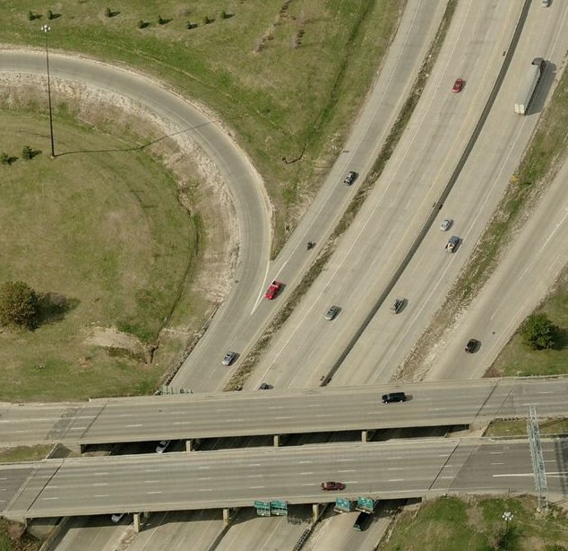
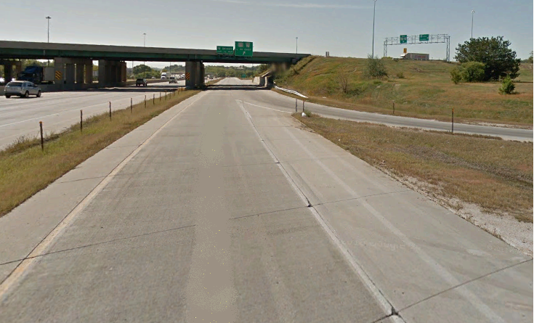
SOUTHBOUND I-680 BRIDGES
CN 22555
WB 80 TO BE FIRST ORDER WITH CONSTRUCTION OCCURRING OVER WITH 3 WEEKEND CLOSURES
PHASE 1A
RESTRIPE WB “I-L-Q CD Road” for 2 lanes
EXISTING LANES
NEW LANES
2
X
RAMP SHIFT
1
OLD STRIPE
L STREET

Slide 10
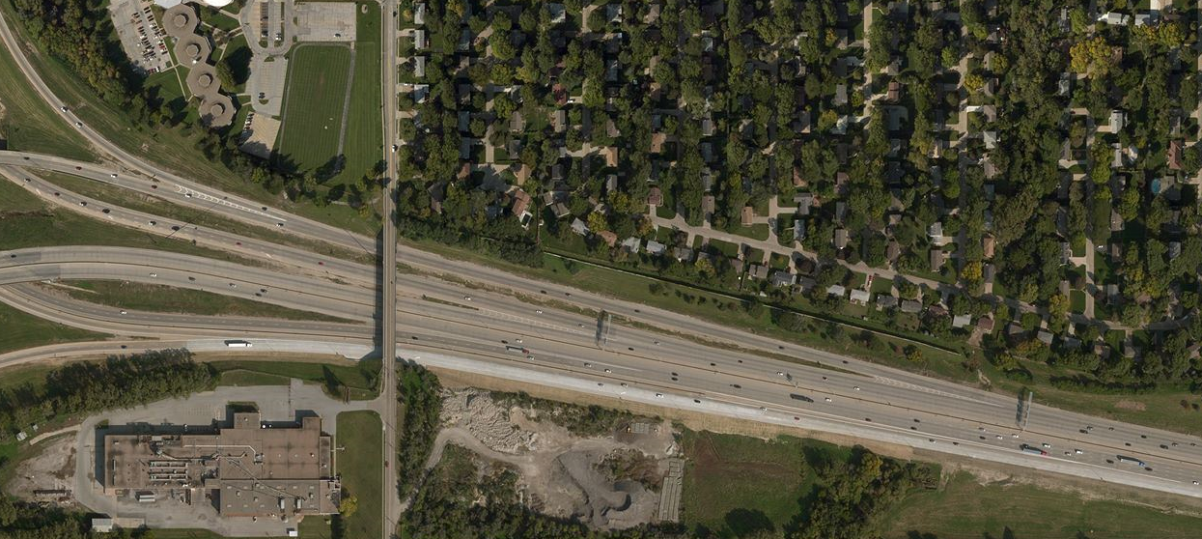
SOUTHBOUND I-680 BRIDGES
CN 22555
PHASE 1B
3 SEPARATE WEEKEND CLOSURES
X
WB I-L-Q CD Road
108TH
BARRELS
THIS STRUCTURE TO BE COMPLETED BY JUNE 10, 2015 TO AVOID CWS

Slide 11
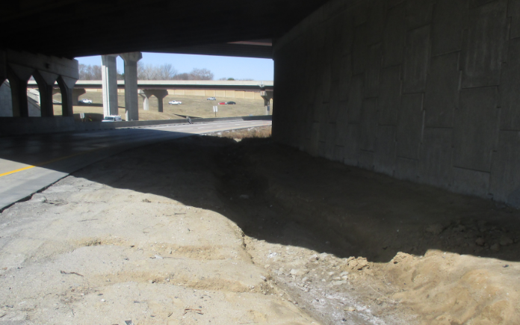

SOUTHBOUND I-680 BRIDGES
CN 22555
ALSO IN PHASE 1
CONSTRUCT BARRIER IN FRONT OF MSE WALL
INTERLOCKING PAVERS
UNDER I-80 BRIDGES
SB I-680 TO EB I-80
THIS WORK TO BE COMPLETED BY JUNE 19, 2015 TO AVOID SEPARATE HIGH FRICTION OVERLAY PROJECT

Slide 12
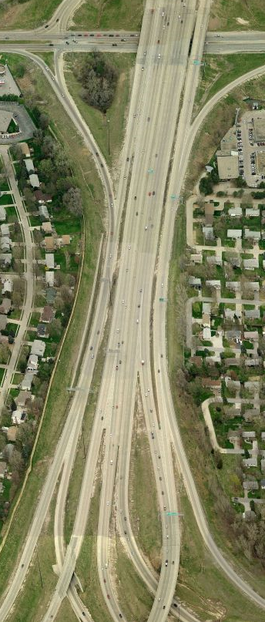
SOUTHBOUND I-680 BRIDGES
CN 22555
PHASE 2
On or before June 11,2015
X
CLOSE W. Center ON-RAMP TO CD ROAD until Aug. 29, 2015
2
WEST CENTER
TRAFFIC
CLOSE SB I-680 to WB I-80 until Aug. 29, 2015
  TRAFFIC DETOURED TO SB I-L-Q CD ROAD
FIRST PRIORITY IS TO RESTRIPE CD ROAD AT WEST CENTER TO A DUAL LANE
X
1
2
CLOSE ON-RAMP TO EB I-80 until Aug. 29, 2015
X
EXISTING ROUTE
DETOUR ROUTE

Slide 13
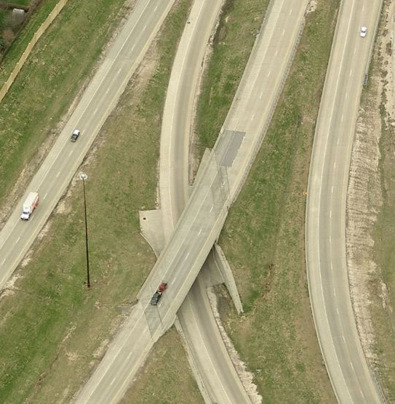
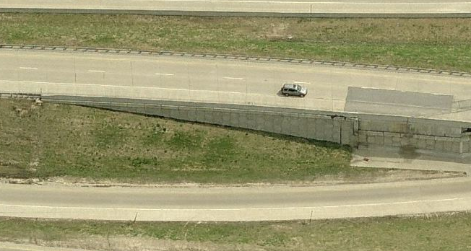
SOUTHBOUND I-680 BRIDGES
CN 22555
S680 00017L
PHASE 3
SB 680 BRIDGE WORK
CONSTRUCTION ITEMS
PARTIAL MSE WALL RECONSTRUCTION
  INCLUDES BARRIER WALL
APPROACH SLABS
ASPHALT OVERLAY

Slide 14
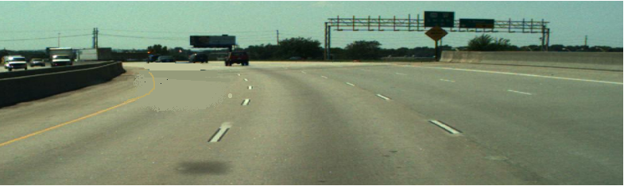
SOUTHBOUND I-680 BRIDGES
CN 22555
PHASE 3
WB I-80 OVER RR OUTSIDE LANES
TRAFFIC
SHIFTED TO INSIDE WB I-80 LANES
NO TRAFFIC FROM SB I-680 INTERFERING
WB I-80 ASPHALT OVERLAY
NON-PEAK STRIPING/BARRIER PLACEMENT
APPROACH WORK/ASPHALT OVERLAY
DUAL LANE
S080 45474L

Slide 15
SOUTHBOUND I-680 BRIDGES
CN 22555
PHASE 4
COMPLETE
WB I-80 OVER RR INSIDE LANES
TRAFFIC
SHIFTED TO OUTSIDE WB I-80 LANES
AGAIN, NO TRAFFIC FROM SB I-680 INTERFERING
ALL WORK COMPLETED BY AUGUST 29, 2015
S080 45474L

Slide 16
Southbound I-680 to Eastbound I-680
HSIP-680-9(34)
$300k
Project can Start July 6th, 2015 with 10 Working Days
Work consists of High Friction Overlay and striping
Traffic Restrictions:
Project will only be constructed during non-peak hours
Non-Peak Hours For Project Are:
Monday Thru Friday 9:00 p.m. to 6:00 a.m.
Friday to Saturday 9:00 p.m. to 8:00 a.m.
Saturday to Sunday 9:00 p.m. to 10:00 a.m.
Traffic Will Be Maintained Throughout Project

Slide 17
Eastbound I-80 to Northbound I-680
STR-80-9(1200) CN 22574
$1.0mil ($4.9 Total Project)
Project Can Start mid-August 2015 Thru October 2015
Work consists of expansion joint replacement
Partial north approach slab replacement
Partial deck repair
Repair and seal concrete rails
3” asphalt bridge deck overlay
Traffic Restrictions:
Maintain single lane thru project
Phase 1 Construction is Lt side of bridge
Phase 2 Construction is Rt side of bridge

Slide 18
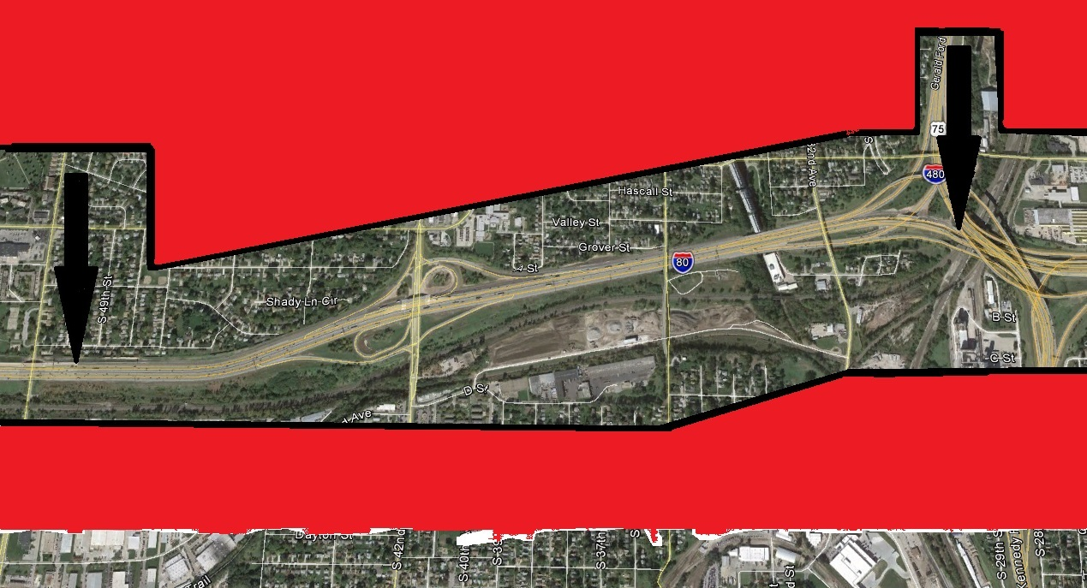
50th Street – I-480, Omaha
NH-80-9(80)
$3.8mil
Work Will Start June 1st, 2015 And Be Allotted 80 Working Days
Work will consist of milling, concrete repair, asphalt paving and striping

Slide 19
Traffic Restrictions
Construction only during Non-Peak Hours
Monday Thru Thursday Are 9:00 p.m. to 6:00 a.m.
Friday To Saturday Is 10:00 p.m. to 7:00 a.m.
Saturday to Sunday Is 10:00 p.m. to 8:00 a.m.
Sunday to Monday Is 10:00 p.m. to 6:00 a.m.
No Work Will be Allowed July 3rd to July 5th And September 5th To 7th
Two Lanes May Be Closed From 11:00 p.m. To Morning Opening Time
On and Off Ramps may be closed but not consecutive interchanges.

Slide 20
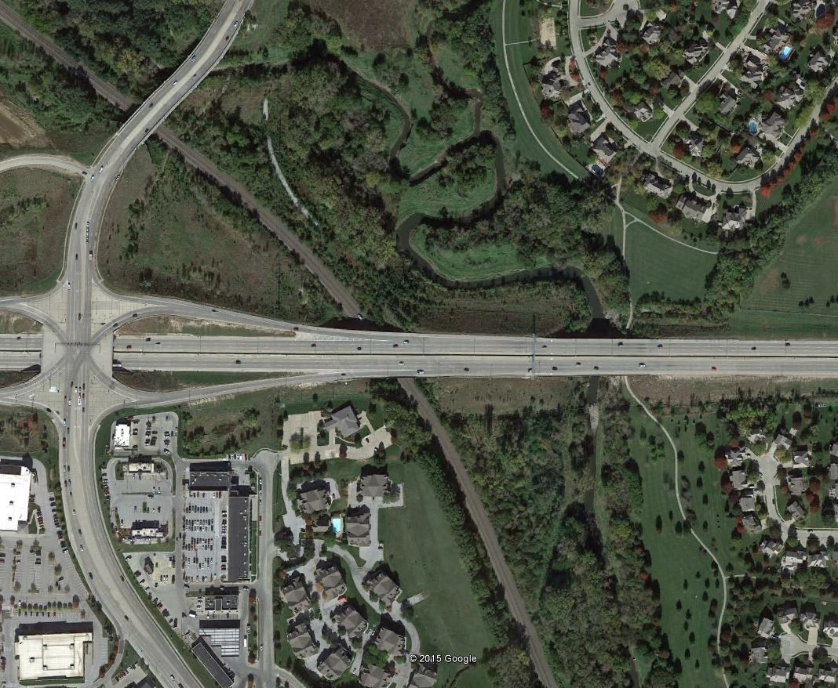
West Papillion Creek Near 168th Street
STR-6-7(1051)
$1.7mil
Work Can Start May 11, 2015
174 Calendar Days
Completion Oct. 31, 2015
Damages assessed at $7690/Day
if not completed by 10/31/15
Work on both EB and WB W. Dodge Road
Work will consist of new approach slabs, bridge deck repair and epoxy polymer overlay, guardrail
US-6
Traffic will be restricted to Two Lanes in each direction for entire project (180th-156th)
Work will occur behind Concrete Barriers
Lane Closures as needed:
Non Peak Hours
10:00 p.m. to 6:00 a.m.
Phase 1: Construct 2 inside lanes
Phase 2: Construct outside lane and shoulder
168th St

Slide 21
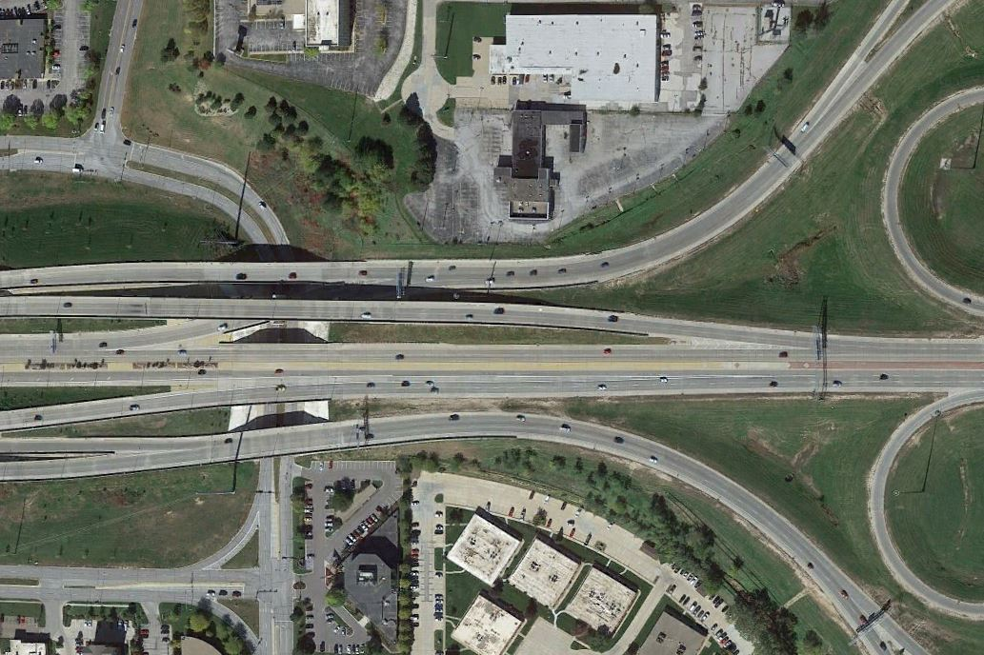
Westbound US-6 Over 108th Street
STR-6-7(1052)
$350k
Work cannot start until after the State Track Meet and must begin between June 1 and July 20, 2015
Allowed 15 Working Days
Work will consist of pavement repair and bridge overlay
US-6
Work will be phased with lane closures

Slide 22
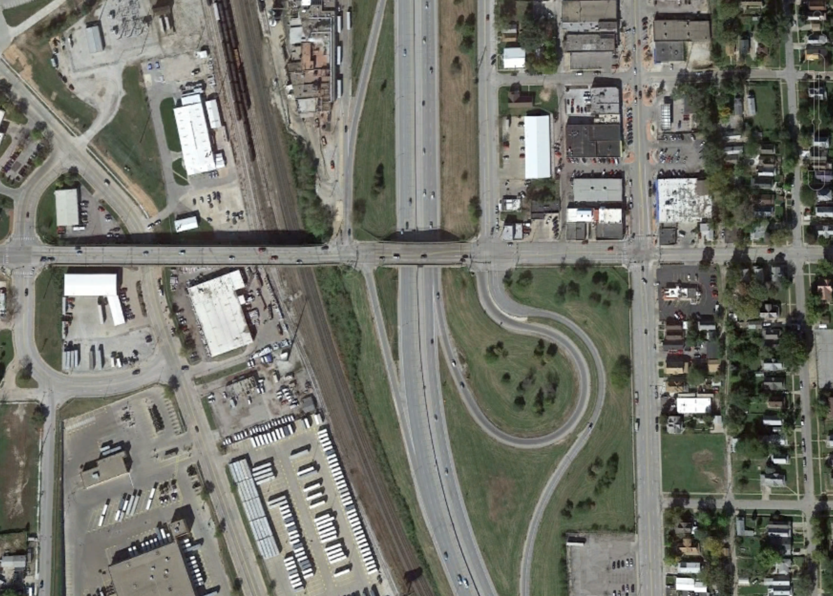
“Q” Street Bridge, Omaha
NH-75-2(174)
$700k
Work cannot start before June 24th, 2015, after College World Series
Allotted 40 Working Days
Work will consist of bridge and concrete repair, 3” asphalt bridge deck overlay
Q St
Phase 1: North Side
Phase 2: South Side
2-lane traffic will be maintained
Pedestrian traffic will be maintained
US-75

Slide 23
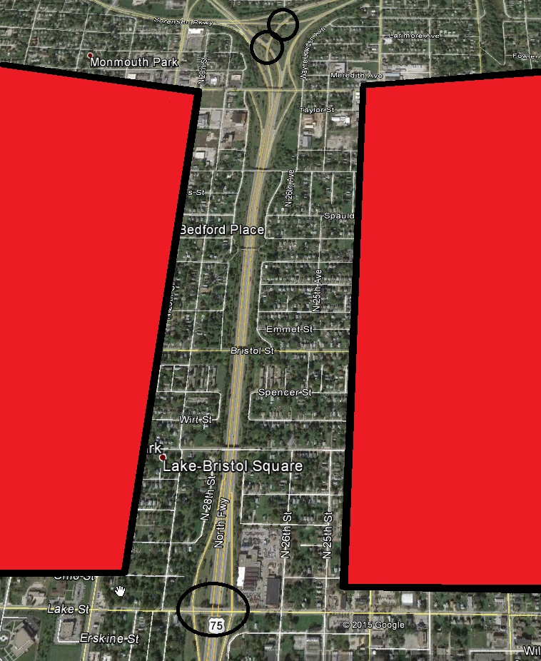
North Freeway Bridges, Omaha
NH-75-2(175)
$1.5mil
Work will consist of bridge deck repair, approach repair and 3” bridge deck overlay
US-75 Bridges:
One lane traffic
will be maintained
Work will occur
behind barriers
Lake St. Bridge:
2-lane traffic will be maintained
One sidewalk will always be open
Work will occur behind barriers
Work Will Start
June 22, 2015
And Is Allotted
75 Working
Days

Slide 24
2015 NDOR District Projects of Note
L28K NH-L28K(103) CN 22542 Military Ave, Papio Creek Bridge $480k
East of Military Ave/Crown Point Ave Intersection
Bridge repair and Deck Overlay
Construct under traffic S 8/15 C 10/15
N-64 NH-64-7(122) CN22539 88th/Maple, Papio Cr Bridge $600k
Bridge repair and Deck Overlay
Construct under traffic S 8/15 C 11/15
N-31 STP-31-2(110) CN 21911 Elkhorn North $9.5mil
Pavement repair, mill/resurface under traffic S 9/14 C 11/15
S28J Washington Bridge closed, traffic detoured on April 6, 2015
N-50 STP-50-2(134) CN 22456 Louisville – Springfield $8.0mil
Pavement repair, mill/resurface under traffic
3 bridges deck repair and overlay
Platte River Bridge – repair joints and abutment S 3/30/15 C 7/16
US-75 S-75-3(1026) CN 22522 Ft. Calhoun – Blair $2.1mil
Pavement repair and overlay under traffic S 10/14 C 6/15

Slide 25
2015 NDOR District Projects of Note
US-77 HSIP-77-3(129) CN 22434 US-77, 5th – 10th St. Fremont $1.0mil
Left turn lanes, resurfacing under traffic S 3/30/15 C 7/15
N-91 STP-91-7(109) CN 22454 Blair West $4.4mil
Mill/resurface under traffic S 3/30/15 C 10/15
N-133 STP-133-3(103) CN21791A Blair South $29.2mil 4-lane expansion S 1/15 C 11/16
2015 close north 1 mile, detour traffic to US-75 S 6/15 C 10/15
US-275 STR-275-7(1044) Waterloo Southeast $1.6mil
High surface friction course on Waterloo Viaduct
Construct Under traffic S 5/15 C 10/15

Slide 26
2015 NDOR District Projects of Note
US-275 M2275B 72nd/L St Bridge $354k
Bridge deck repair and 2” asphalt overlay Summer 2015
US-6 M2006 156th/W. Dodge Road $132k
EB Exit Cantilever Sign Summer 2015
I-80 M2080 I-80/60th St $618k
4 Cantilever Signs Summer 2015
I-80 M2080C I-80/13th St $836k
6 Cantilever Signs Summer 2015
I-80 M2080D I-80/42nd St $272k 2 Cantilever Signs Summer 2015
I-680 M2680 I-680/W. Dodge Road $294k
2 Cantilever Signs Summer 2015

